Slide 1
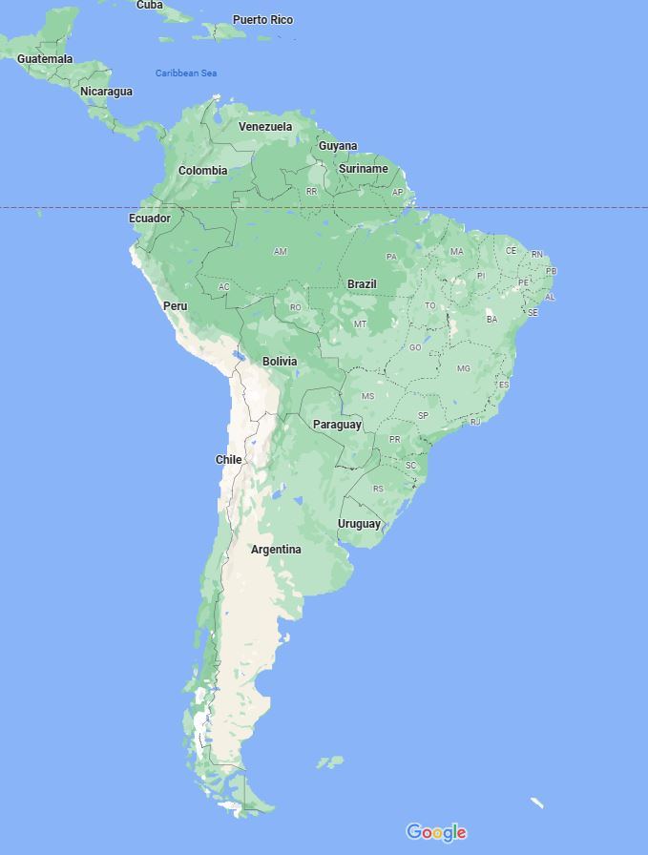
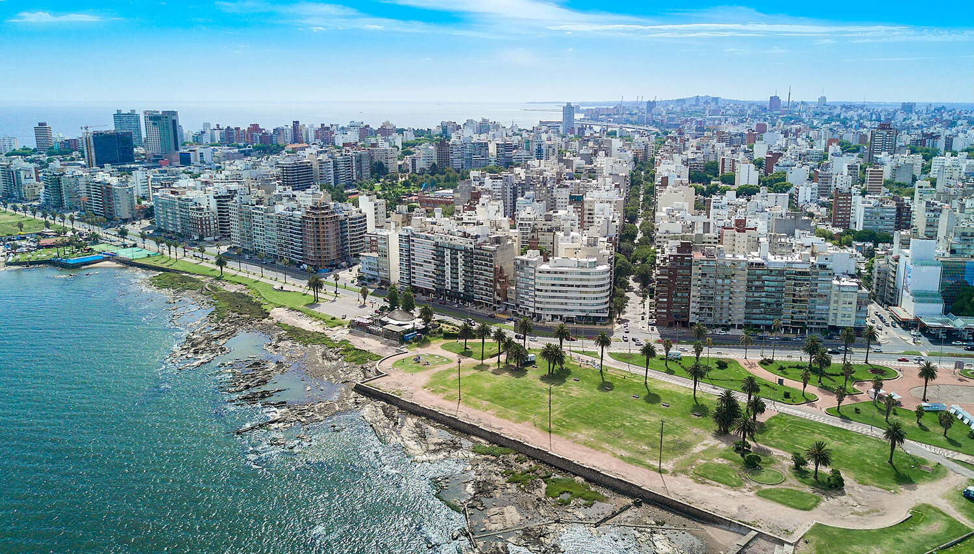
Uruguay
By: John Oliveira and Thomas Whittle

Slide 2
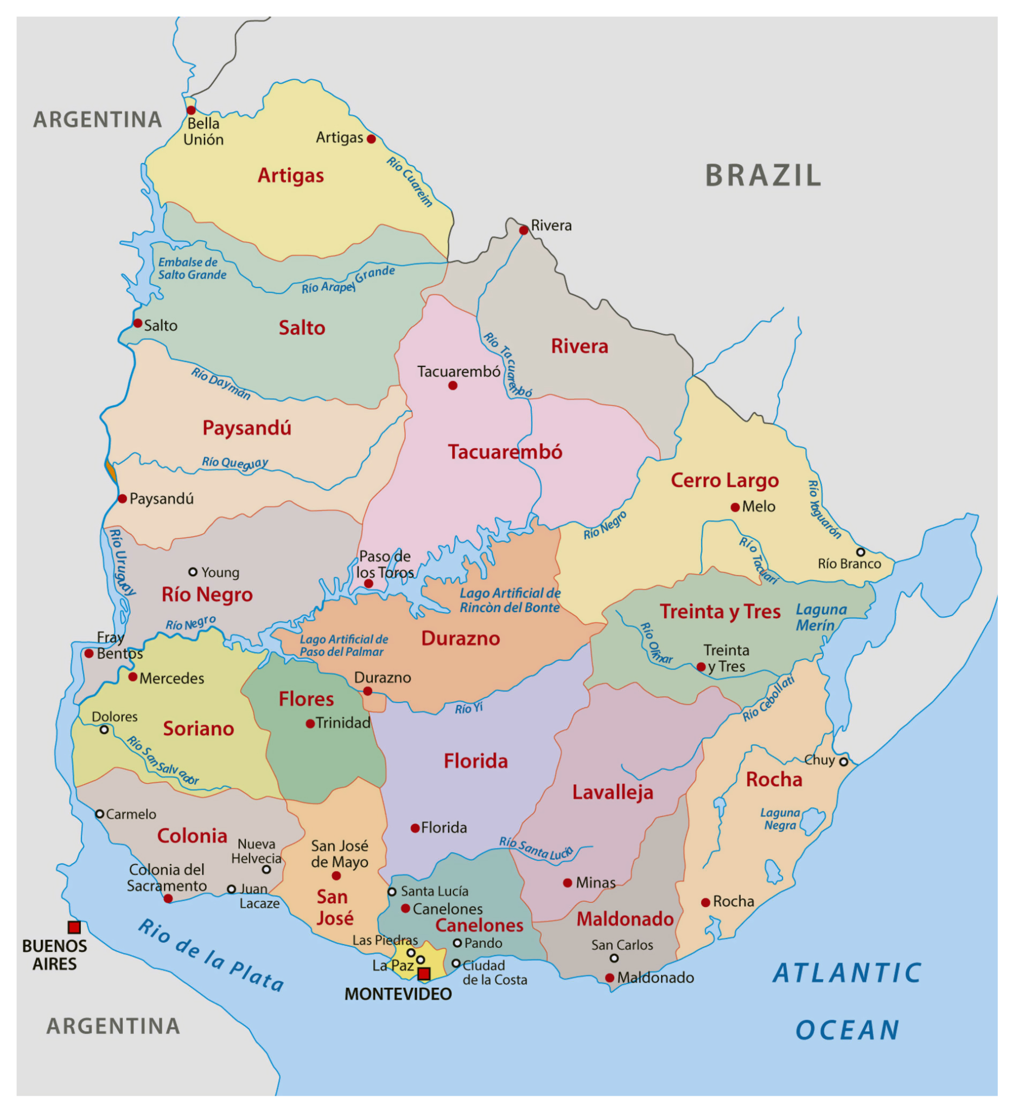
General Demographics of Uruguay
Population: 3,500,000
Capital City: Montevideo
Official Language: Spanish, Fronteirico (mostly in Rivera)
Official Religion: Roman Catholic
Government Type: Representative Democratic Republic:
General Assembly + Supreme Court

Slide 3
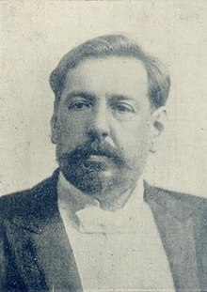
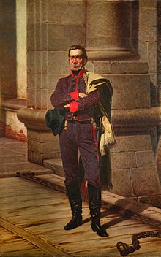
History of Uruguay Part 1
Brief History of Uruguay:
26 February 1811 José Gervasio Artigas proclaims independence from Spanish Empire
Brazilian Empire captures Banda Oriental in 1816
1825 The Thirty-Three Orientals Revolutionary group led by Juan Antonio Lavalleja with Argentine support declares war of independence for region from Brazilian rule
1830 Full Independence
José Batlle y Ordóñez’s government modernized country 1903-1933 after period of civil wars
Modern Uruguay considered best country for workers’ rights in South America
Photograph of José Batlle y Ordóñez in office (Wikipedia)
Painting of José Gervasio Artigas by Juan Manuel Blanes (Wikipedia)
Notes:
History of Uruguay - Wikipedia

Slide 4
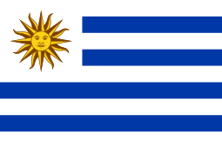
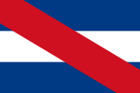
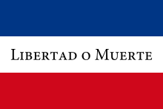
Co-Official Flags of The Oriental Republic of Uruguay
The National Flag of Uruguay
The Flag of Artigas
The Flag of
Treinta y Tres
Notes:
Flag of Artigas Notes: Made official as a Co-Flag in 1952 to Celebrate Jose Gervasio Artigas (national hero). Modeled after the Belgrano flag of Argentina but added a Red Stripe to represent Artigas’ Federal Republic
Flag of 33 Notes: Originally made to represent the countries’ expedition in the Cisplatine War for independence from the Empire of Brazil in the 1820s. The Flag represents the 33 Oriental Provinces (Treinta y Tres Orientales) that made up what is now Uruguay
National Flag Notes: Inspired by both the Stars and Stripes flag of the US and Argentina’s Belgrano flag, the National Flag symbolizes the 9 original departments of Uruguay with the Sun of May representing the May Revolution of 1810 when Argentina, Uruguay, etc symbolically announced their independence from Spain after Napoleon installed Joseph Bonaparte as Spanish King

Slide 5
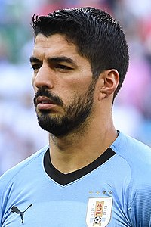
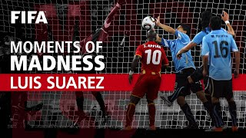
Fútbol in Uruguay
Official Name: Selección de fútbol de Uruguay
Nickname: La Celeste (Sky Blue)
Home Stadium: Estadio Centenario in Montevideo
Accolades:
16x Copa America Champions (tied with Argentina most All-Time)
2x FIFA World Cup Winners (1930 and 1950)
3x FIFA World Cup 4th Place Finishes (1954, 1970, 2010)
2x Olympic Gold Medalists (1924 and 1928)
Famous Players:
Luis Suárez (Most Goals All-Time)
Edinson Cavani
Diego Godín (Most Caps All-Time)
Diego Forlán
Top: Picture of Current Team Captain Luis Suárez (Wikipedia)
Left: Video from Quarter Finals of 2010 World Cup in South Africa (Youtube)
Notes:
Video Link: Luis Suarez Handball Against Ghana | South Africa 2010 | FIFA World Cup - YouTube

Slide 6
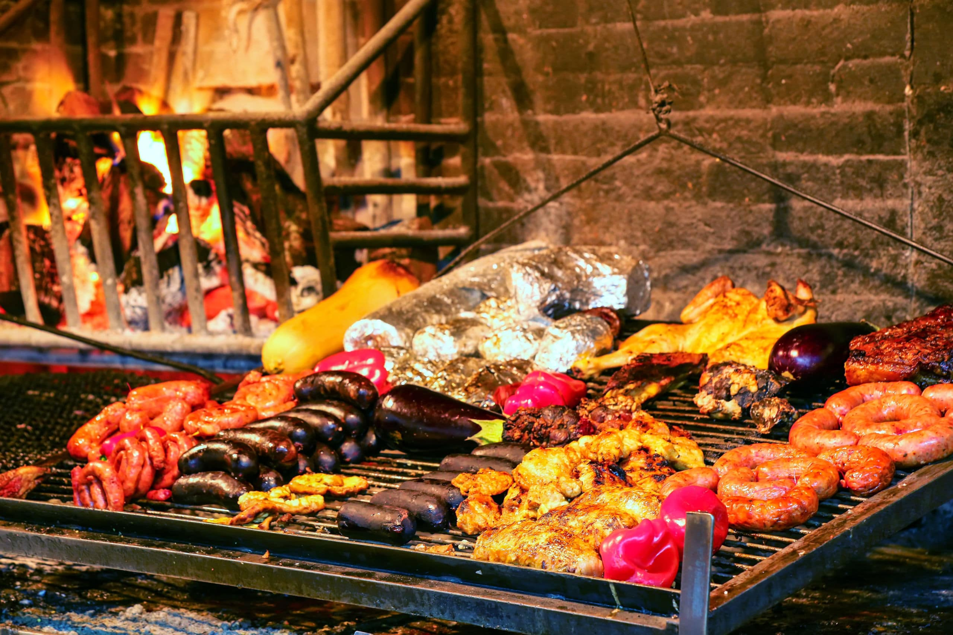
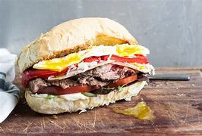
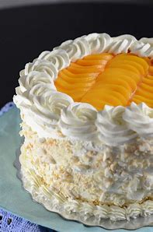
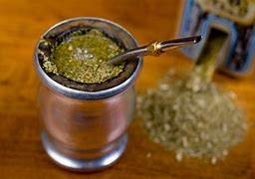
Food in Uruguay
Top: Asado Uruguayo
Top: Chivito Sandwich, the official food of Uruguay
Right: Chajá Cake
Left: Yerba maté Drink

Slide 7
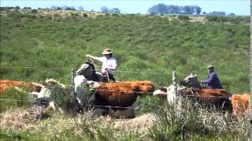
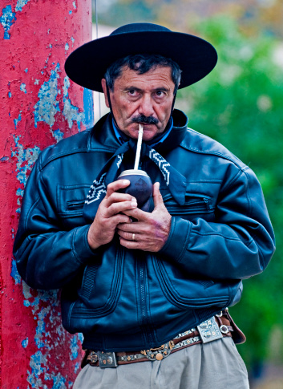
Uruguay “Gauchos” Part 1 (they are really cool)
Gaucho/Bowlero
Maté Drink
Above: “The Gauchos of Uruguay”
https://www.youtube.com/watch?v=njpOqoBrEfs
Right: Gaucho wearing traditional attire
Chiripá /Tirador
Bombachas de campo
Notes:
https://www.youtube.com/watch?v=njpOqoBrEfs

Slide 8
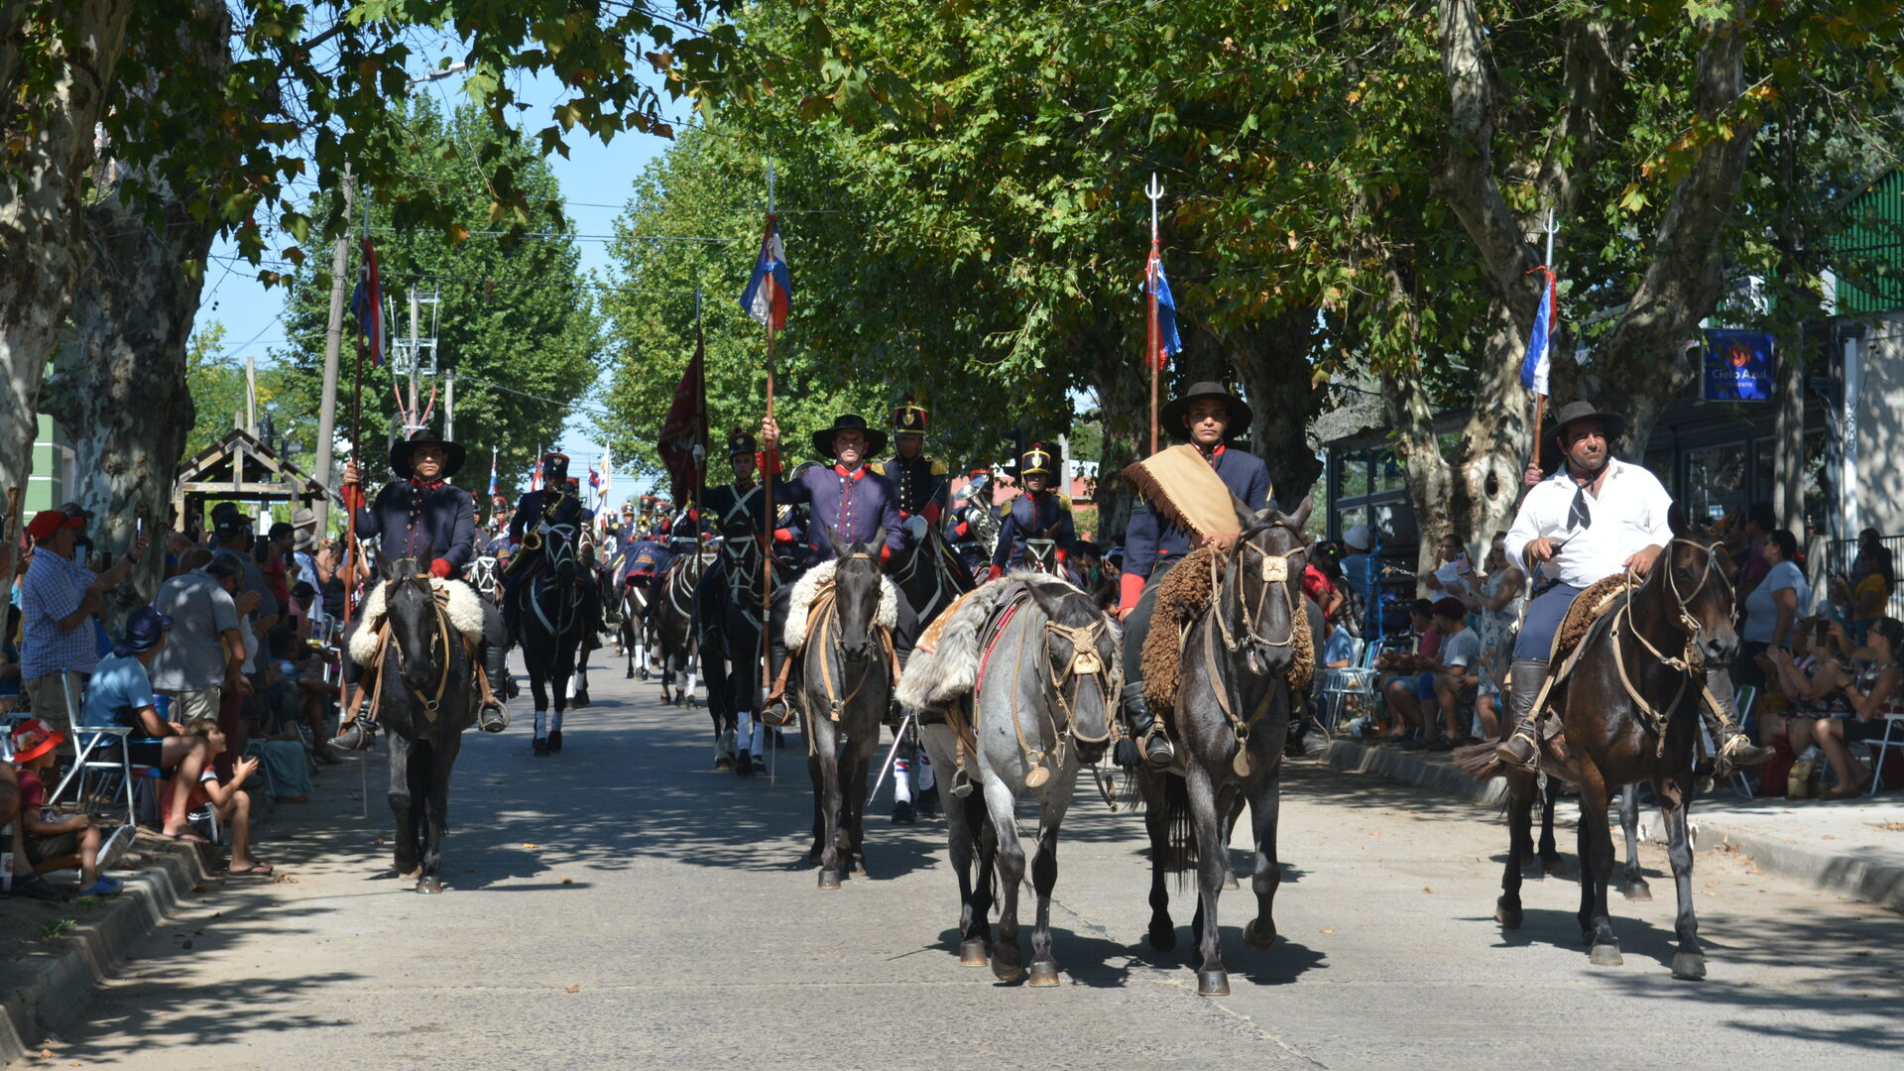
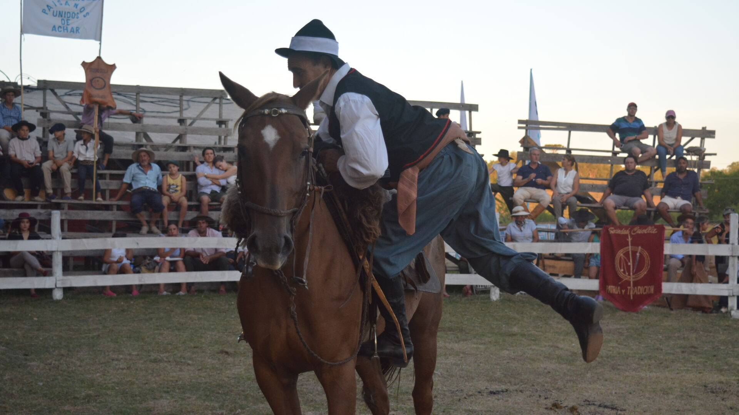
Uruguay “Gauchos” Part 2 (they are still really cool)
Left: 11 March 2023 “Desfile de Gaucho” at Tacuarembó during “Fiesta de la Patria Gaucha”
Right: A Gaucho mounts a horse during the “Concurso de Montado de Trabajo” on 11 March 2023
Notes:
https://www.patriagaucha.com.uy/fotos

Slide 9
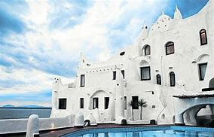
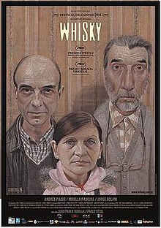
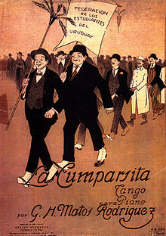
Art Forms of Uruguay
Top: “A Livable Sculpture”
by Carlos Páez Vilaró
(his personal home, hotel, and museum)
Right: Uruguay’s budding film industry: Whisky has earned international awards
Top: 1916’s La cumparsita tango
La cumparsita - Wikipedia

Slide 10
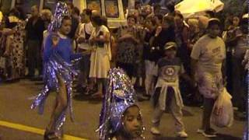
Candombe Video
Notes:
https://www.youtube.com/watch?v=MzJWLeaMGag&t=1s

Slide 11
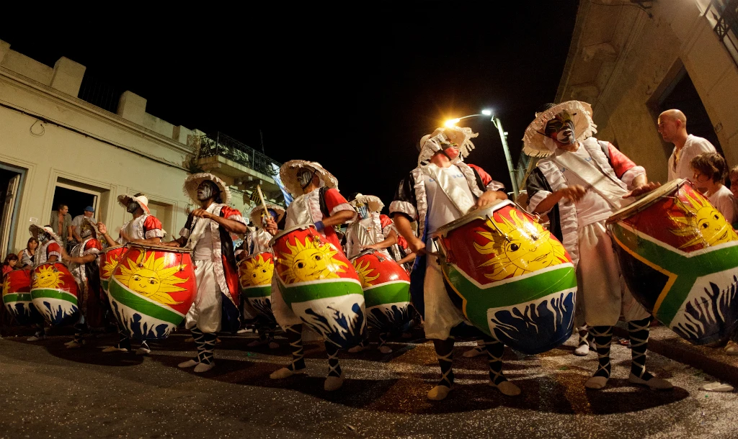
Candombe Picture

Slide 12
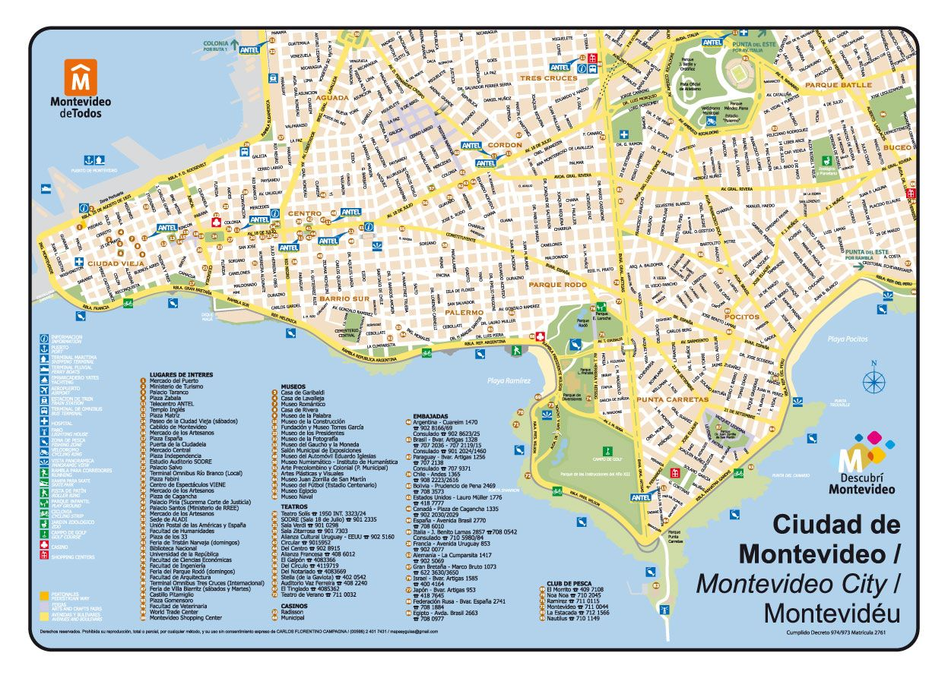
Important Places in Uruguay: Montevideo
Attractions in Montevideo
La Rambla - 10 mile waterfront
Teatro Solís - 2nd Oldest Theatre in S.A.
Mercado del Puerto - Converted Marketplace
Plaza de Independencia - in Old Town
Fortaleza del Cerro/de General Artigas - Not Pictured

Slide 13
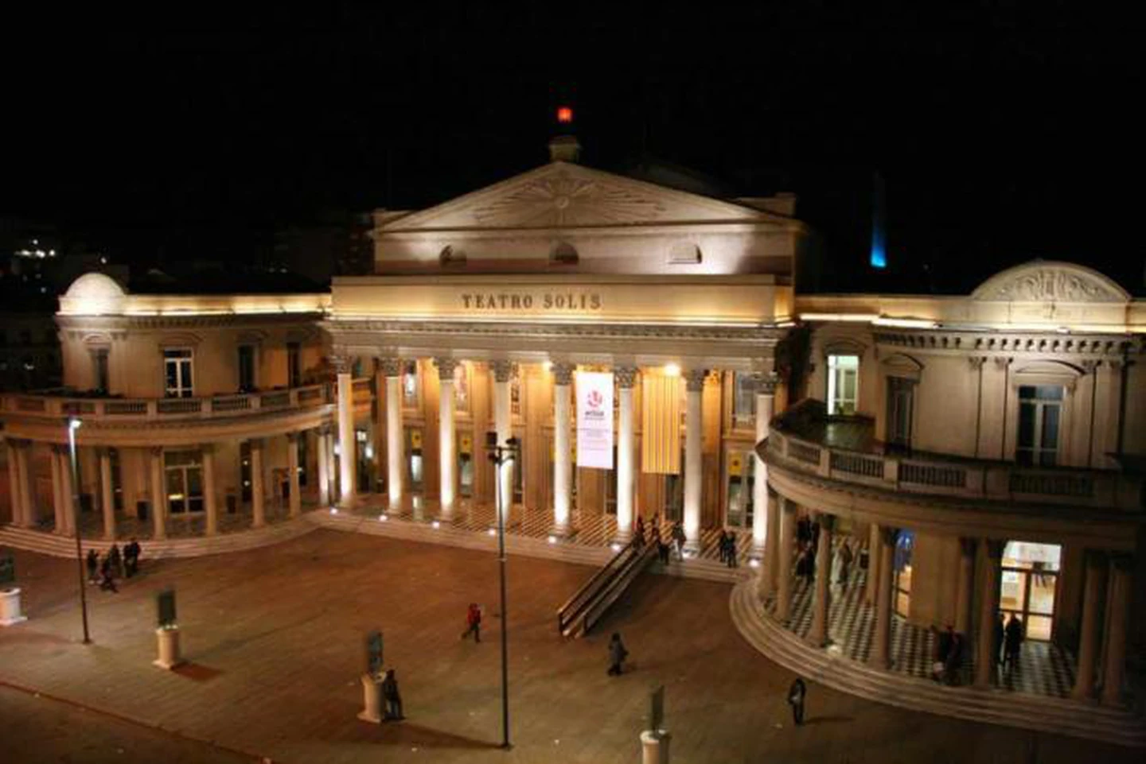
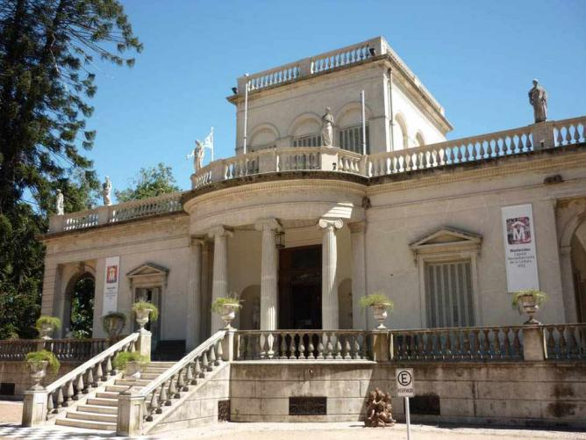
Important Places in Uruguay: Montevideo
Top: Museum of Fine Arts:
Museo Municipal de Bellas Artes Juan Manuel Blanes
Left: Montevideo’s Teatro Solís

Slide 14


